Slide 1

3 DOF Articulated Manipulator with Pick & Place Operation Based on Inverse Kinematics
Completed in
Special Studies and Project (MTE 3200)
Presented By
Shahriar Ferdous
Roll: 1831002
Year: 3rd
Semester: 2nd
Department of Mechatronics Engineering
Khulna University of Engineering & Technology(KUET)
Khulna-9203, Bangladesh
Supervised By
Dr. Asief Javed
Assistant Professor
Department of Mechatronics Engineering
Khulna University of Engineering & Technology(KUET)
Khulna-9203, Bangladesh
1

Slide 2
Content
Objectives
Project Summary
Equipment
Experimental Setup
Operation
Results
Advantages and Disadvantages
Applications
Future Scope
Conclusion
2

Slide 3
Objectives
To design and build a low-cost 3 DOF articulated manipulator.
To test and complete a pick and place operation.
To use the inverse kinematics to complete the pick and place mission.
3

Slide 4
Project Summary
Articulated manipulator robots is often used in industry with various tasks, one of which is a pick and place.
Rapid prototyping of robot arms is needed to facilitate the development of many industrial tasks, especially on a laboratory scale.
This project aims to design a small-scale three degree of freedom (3-DoF) robot arm for pick and place operation using the inverse kinematics method. The mechanical robotic arm is open sourced
Four servo motors are used as the actuator with a 16 channel 12-Bit PWM Drive.
Arduino Uno R3 is used as a microcontroller in which the inverse kinematic method is embedded. This method is used to move the robot based on the coordinates of the destination pick and place.
4

Slide 5
Equipment
No | Specification | Type
1 | Microcontroller | Arduino Uno R3 ATMega 328P, operating voltage 5V,14 digital I/O pins, 6 analog input pins, clock speed 16 MHz
2 | Servo Motor | MG996R -Torque 9.4 Kgf.cm (4.8V) -Torque 11 Kgf.cm (6V) -Operating voltage 4.8-7.2V SG90 (elbow and gripper) -Torque 1.2 Kgf.cm (4.8V) -Torque 1.6 Kgf.cm (6V) -Operating voltage 3-7.2V
3 | Servo Driver | PCA9685 - 16 Channel, 12 Bit - Vcc 3 – 5V - Logic 3 -5V V+ 6V Max Freq 40 – 1000Hz
4 | Links | 4 (base, shoulder, elbow, gripper)
5

Slide 6
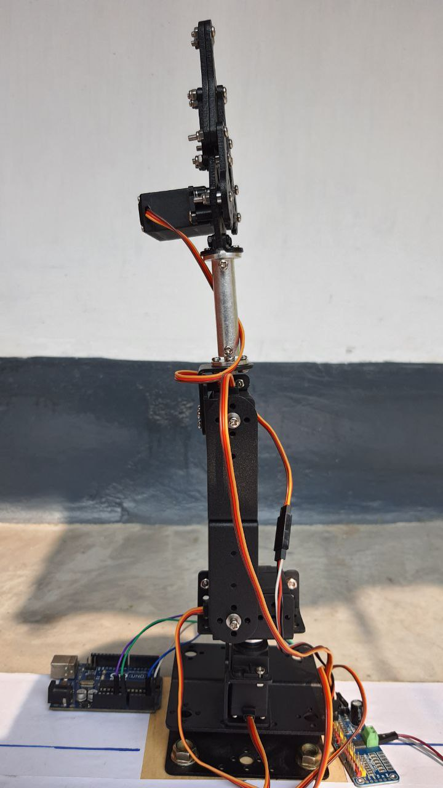
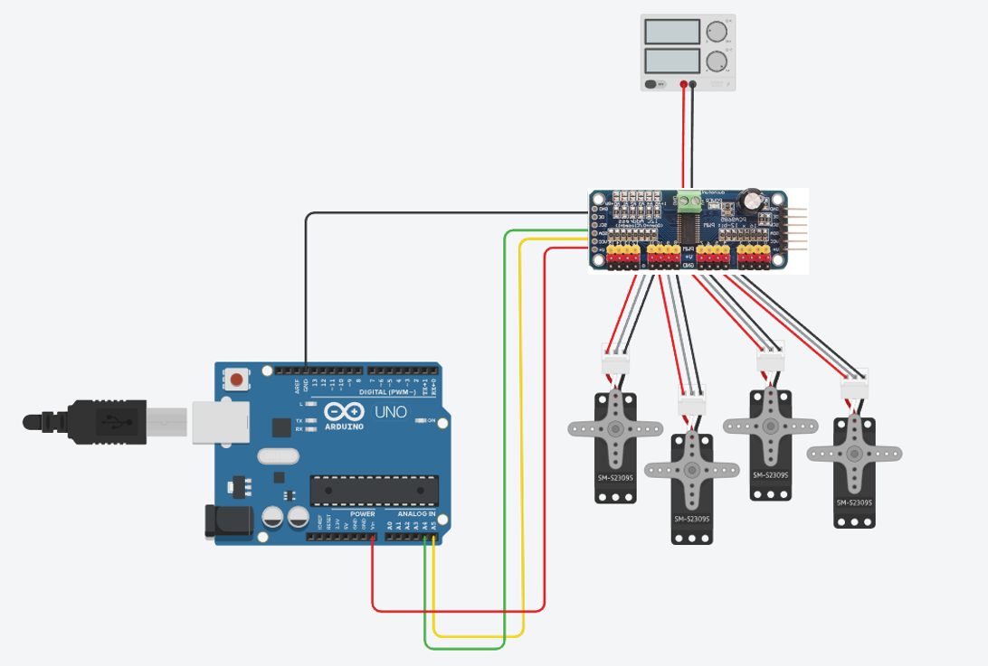
System Design
End Effector
Link 3
Joint 3
Link 2
Link 1
Joint 1
Joint 3
Joint 2
Joint 2
End Effector
Joint 1
Base
Fig 1: Overall System and Circuit Design
Fig 2: Robotic Manipulator Design
6

Slide 7
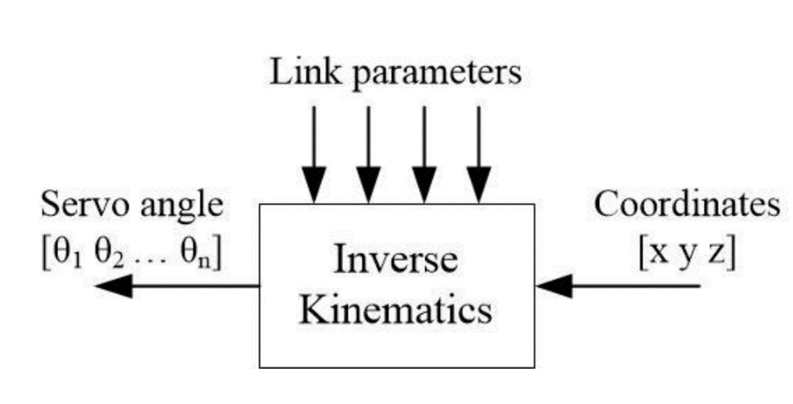
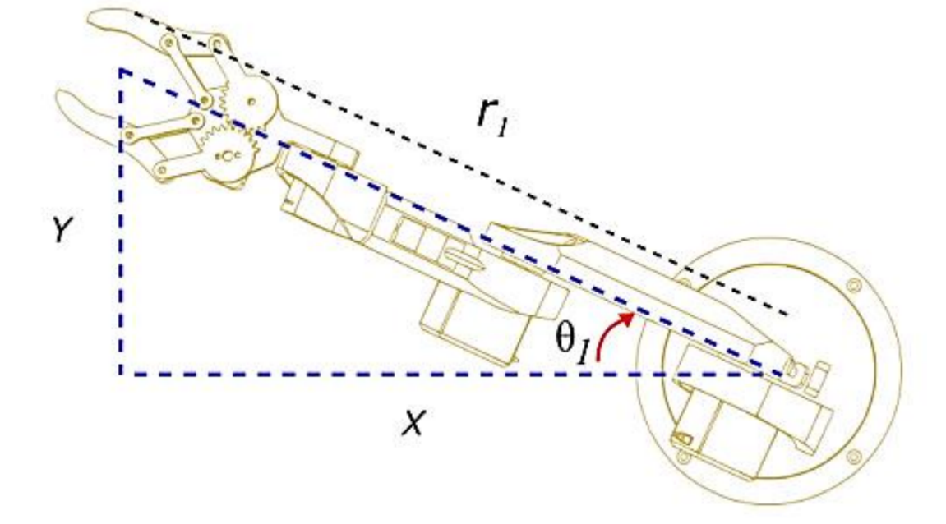

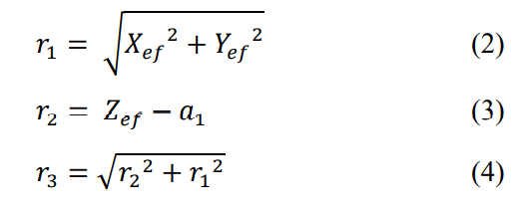
Inverse Kinematics (Mathematical Modelling)
Fig. 3. Inverse kinematics mechanism
Fig. 4. Robot top view
7

Slide 8
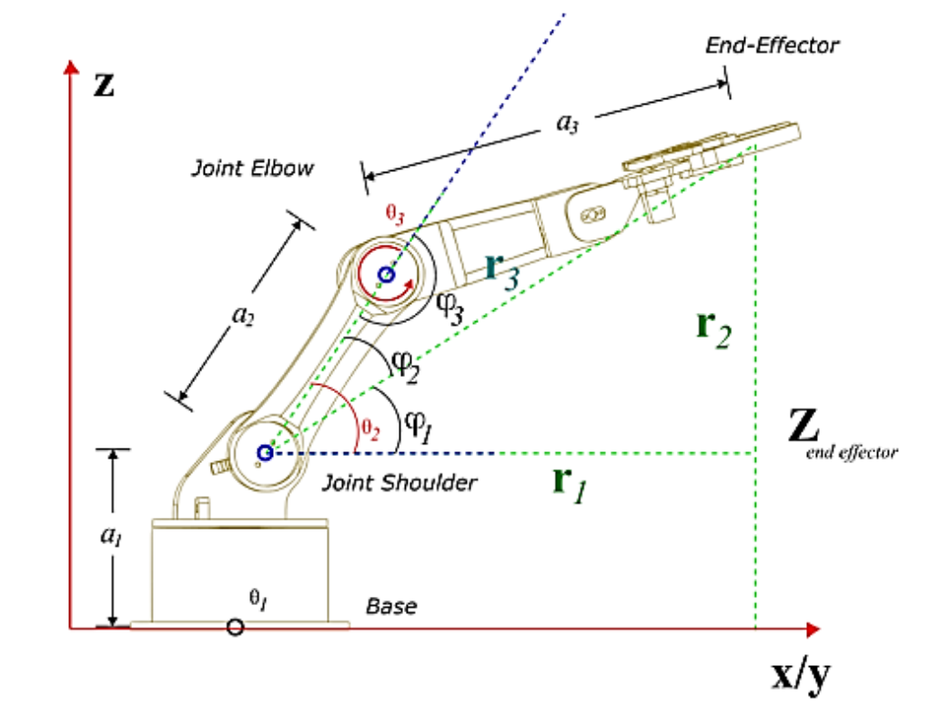
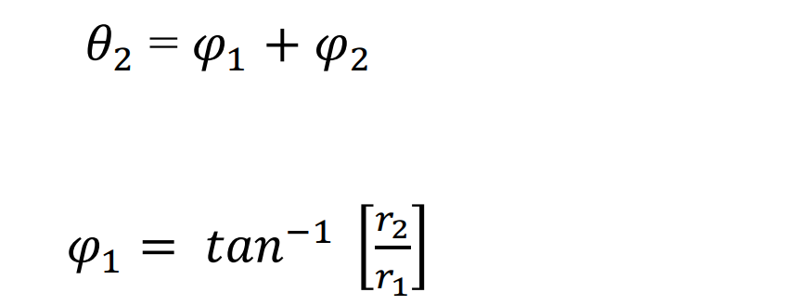

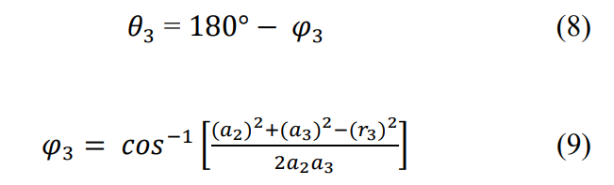
Inverse Kinematics (Mathematical Modelling)
Where
Fig. 5. Robot side view
Where
8

Slide 9
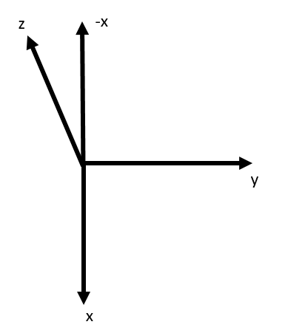
Result
Table 2. Cost of the components used in 3 DOF articulated manipulator
SL | x-axis(cm) |  | y-axis(cm) |  | z-axis(cm)
 | Input | Output | Input | Output | Input | Output
2 | 10 | 8.8 | 10 | 11.3 | 10 | 8.1
a | 0 | 0.3 | 25 | 26.3 | 8 | 6.8
4 | 9 | 8.1 | 15 | 15.4 | 12 | 10.7
5 | 12 | 11.1 | 20 | 21.2 | 15 | 13.6
Fig 7: Coordinate Axis system
9

Slide 10
Cost
Table 3. Cost f the components used in 3 DOF articulated manipulator
SL no. | Name of the components | Quantity | Unit price (BDT) | Total price (BDT)
1 | 3 DOF Manipulator Frame | 1 | 2500 | 2500
2 | Arduino Uno R3 | 1 | 1100 | 1100
3 | Servo Motor MG 996 | 4 | 450 | 1800
4 | 16 Channel 12-bit PWM/Servo Driver | 1 | 530 | 530
5 | External Frame | 1 | 400 | 400
Total cost: Six Thousand Seven Hundred Twenty Taka Only |  |  |  | 6,330
10

Slide 11
Application & Future Scope
Application
To satisfy the learning needs in the laboratory
To do rapid prototyping of manipulation system
To teach students robotics in educational institutions
Future Scope
Upgraded to 4 DOF
User Friendly UI (User Interface)
Educational Features (IoT based operations)
11

Slide 12
Conclusion
A small-scale 3 DOF manipulator robot arm with a pick-and-place mission based on inverse kinematics has been designed, implemented, and tested successfully.
The inverse kinematics method that is applied can make the robot perform a pick-and-place mission for several coordinate targets.
The system takes coordinates of x, y, and z as input and moves the joints automatically to reach the end effector to the target coordinate.
Then the jaw of the end effector opens and picks an object. After that, the end effector moves to the place coordinates to finally place the object. The pick and place coordinates can be given using Arduino code.
There are some slight errors which can be mitigated using sophisticated 3D printed build materials and good quality servo motors
12

Slide 13
Thank You
13

Slide 14
Any Questions?
14

